Slide 1
MicroPython
IOT 入門
Speaker: Jumbo
email: jumbokh@gmail.com

Slide 2
Agenda
ESP32-s: MicroPython Firmware
Sensor: DHT11
MQTT How to
Monitor with APP @ Phone
Control a light or switch
Draw a Chart
More about MQTT
https://goo.gl/ciQ8rw

Slide 3
1.
ESP32-S: MicroPython Firmware
Let’s start with the first set of slides

Slide 4
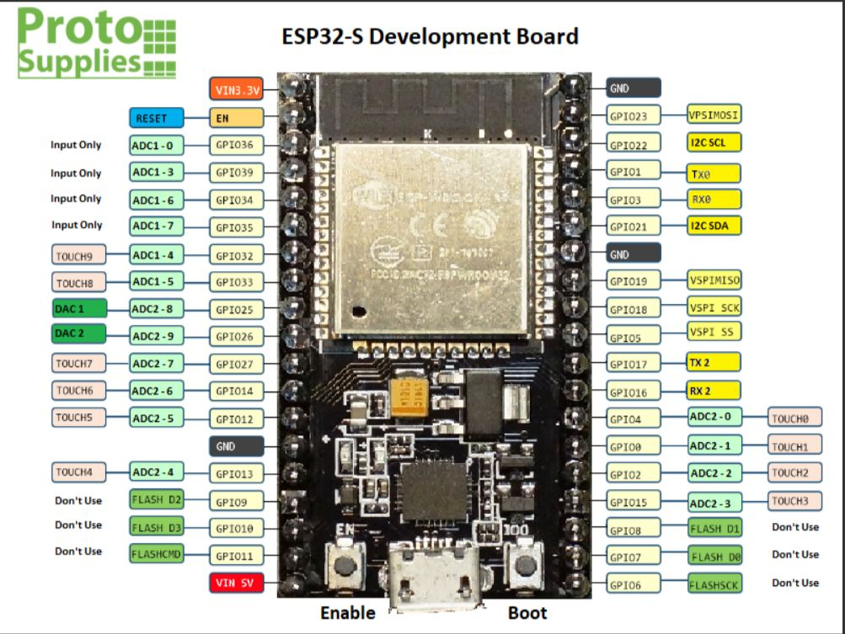
Flash firmware
參考文章
下載Firmware:
http://micropython.org/download#esp32
先Erase：
esptool.py --port com12 erase_flash
再燒錄：
esptool --port com4 --chip esp32 write_flash -z 0x1000 esp32-idf3-20191202-v1.11-611-g7f24c2977.bin
(32m-->32Mb-->4MB)

Slide 5
After flash fw.
esptool.py --port com12 flash_id
esptool.py v1.3
Connecting....
Manufacturer: e0
Device: 4016
esptool.py --port com12 chip_id
esptool.py v1.3
Connecting....
Chip ID: 0x00a3c7f0
Notes:
燒錄指令：
esptool.py --port com12 --baud 460800 write_flash --flash_size=detect -fm dio 0 py-esp8266-20170108-v1.8.7.bin
以下為過程的訊息，32m-->32Mb-->4MB
esptool.py v1.3
Connecting....
Auto-detected Flash size: 32m
Running Cesanta flasher stub...
Flash params set to 0x0240
Wrote 589824 bytes at 0x0 in 13.2 seconds (357.5 kbit/s)...
Leaving...

Slide 6
Hello World with GPIO
DEMO:
hello-gpio.py
Hello World MicroPython :
舊版可用p.low(), p.high()，新版只能用.value()
import machine
import time
p = machine.Pin(2, machine.Pin.OUT)
for i in range(6):
p.value(not p.value())
time.sleep(1)

Slide 7
ampy: 透過serial操作的好工具
說明頁面：adafruit-ampy
How to install: pip install adafruit-ampy
put script into board: ampy --port com12 put test.py ampy --port com12 put dir2
Run code: ampy --port com12 run test.py
Run code forever but no waiting ampy --port com12 run test2.py --no-output

Slide 8
ampy: 透過serial操作的好工具
Reset ESP32-S ampy --port com12 reset
List files ampy --port com12 ls ampy --port com12 ls dir2
Make dir ampy --port com12 mkdir dir3
Remove dir ampy --port com12 rmdir dir3
Remove file ampy --port com12 rm data.txt

Slide 9
ampy: 透過serial操作的好工具
get script from board: ampy --port com12 get boot.py Get boot.py, and then save as my-boot.py on PC ampy --port com12 get boot.py my-boot.py

Slide 10
2.
Sensor: DHT-11

Slide 11
DHT-11 (溫溼度sensor)
DEMO:
dht11.py
import dht import machine d = dht.DHT11(machine.Pin(4)) d.measure() d.temperature() # eg. 23 (°C) d.humidity() # eg. 41 (% RH) d = dht.DHT22(machine.Pin(4)) d.measure() d.temperature() # eg. 23.6 (°C) d.humidity() # eg. 41.3 (% RH)
Notes:
https://akizukidenshi.com/download/ds/aosong/DHT11.pdf

Slide 12
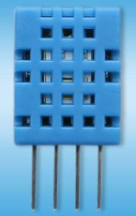
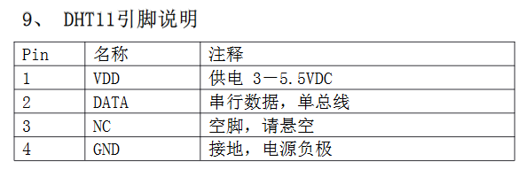
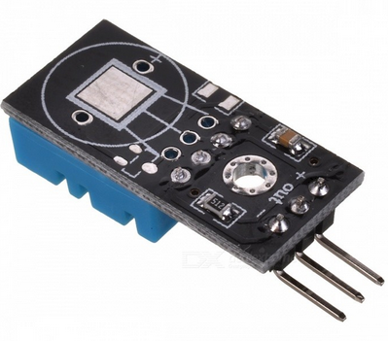
DHT-11 (溫溼度sensor)
DEMO:
dht11.py
Ref: https://akizukidenshi.com/download/ds/aosong/DHT11.pdf

Slide 13
3.
MQTT How to

Slide 14
MQTT
DEMO:
mq-dht11.py
MQTT (Message Queue Telemetry Transport)
為M2M, IOT設計的協定，基於TCP socket，主要是想讓系統資源較低的設備也可以把資料上傳到Server。
目前已是ISO的一員 2016, MQTT is now an ISO standard (ISO/IEC 20922)
此處使用的MQTT雲端為Eclipse所提供： iot.eclipse.org

Slide 15
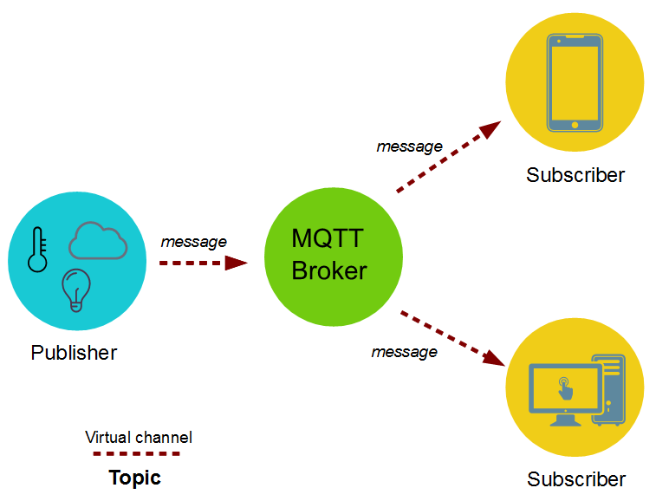
MQTT
來源網址

Slide 16
MQTT Demo 執行前先修改的部份
DEMO:
mq-dht11.py
TOPIC_BASE = 'iot/home2' 改為你自己的topic名稱
server = "iot.eclipse.org" 若有自己的MQTT Broker請俢改此行
wlan.connect(‘SSID', ‘Key') 依現場的網路修改帳密
其它的免費的MQTT： iot.eclipse.org test.mosquitto.org broker.hivemq.com cloudMqtt (要申請)

Slide 17
4.
Monitor with APP @ Phone

Slide 18
MQTT
使用手機為Android手機 (iPhone我沒有，因此沒試過)
請安裝MQTT Dashboard這個APP。

Slide 19
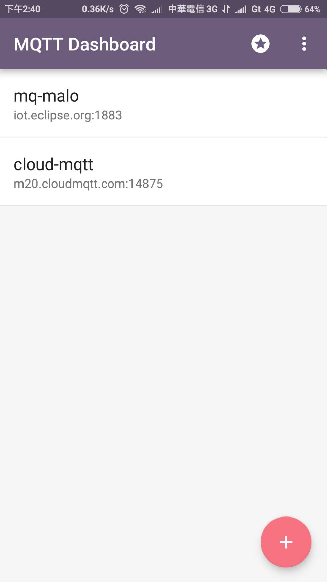
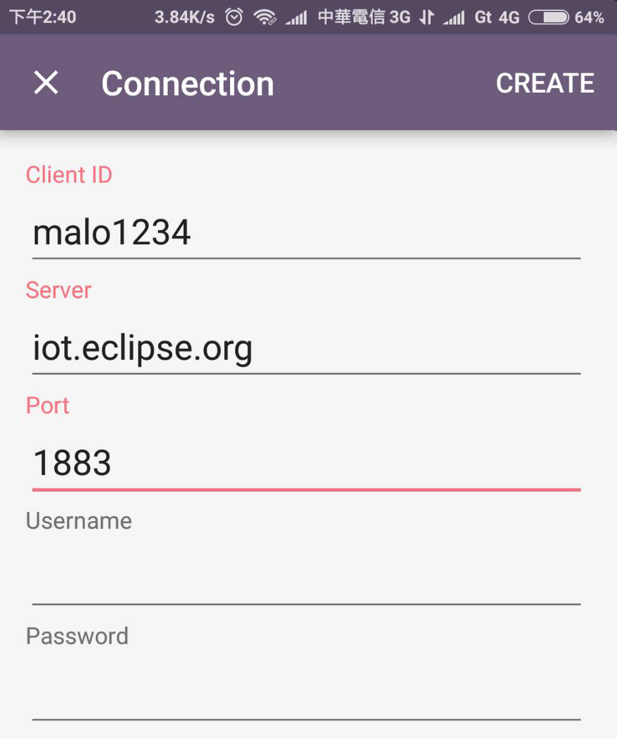
MQTT
(1)裝好後按+新增一個project
(2)填入Server, Port訊息 Client ID任意填
(2)
(1)

Slide 20
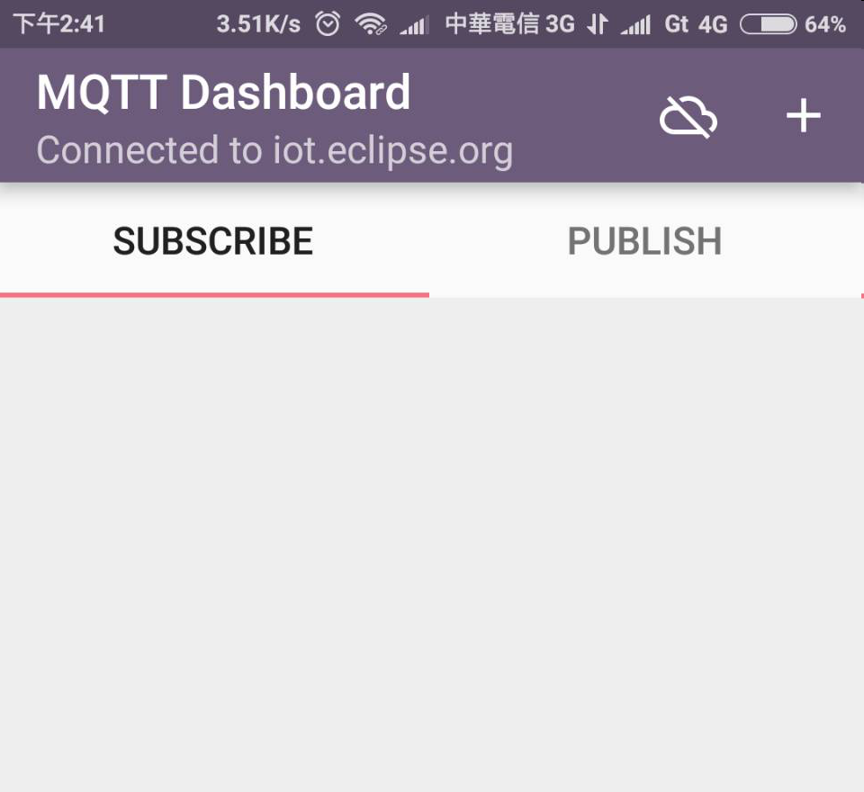
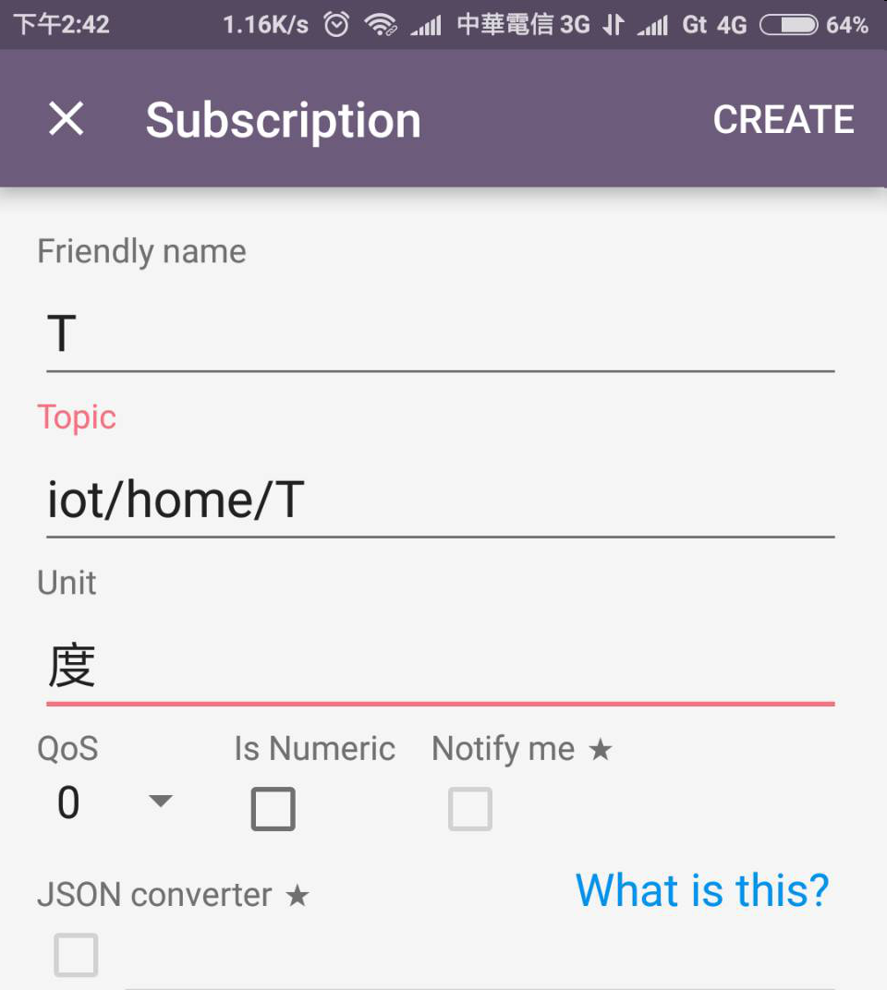
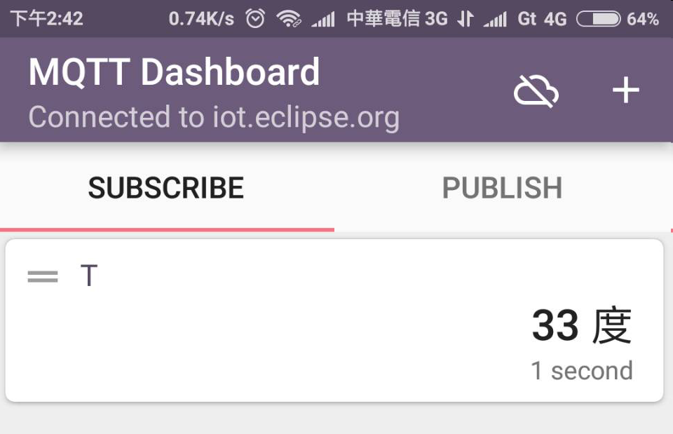
MQTT
(3)
(3)按+新增一個訂閱(Subscript)的 主題(Topic)
(4)填入如圖的內容
新增完成畫面如下
(2)
(4)

Slide 21
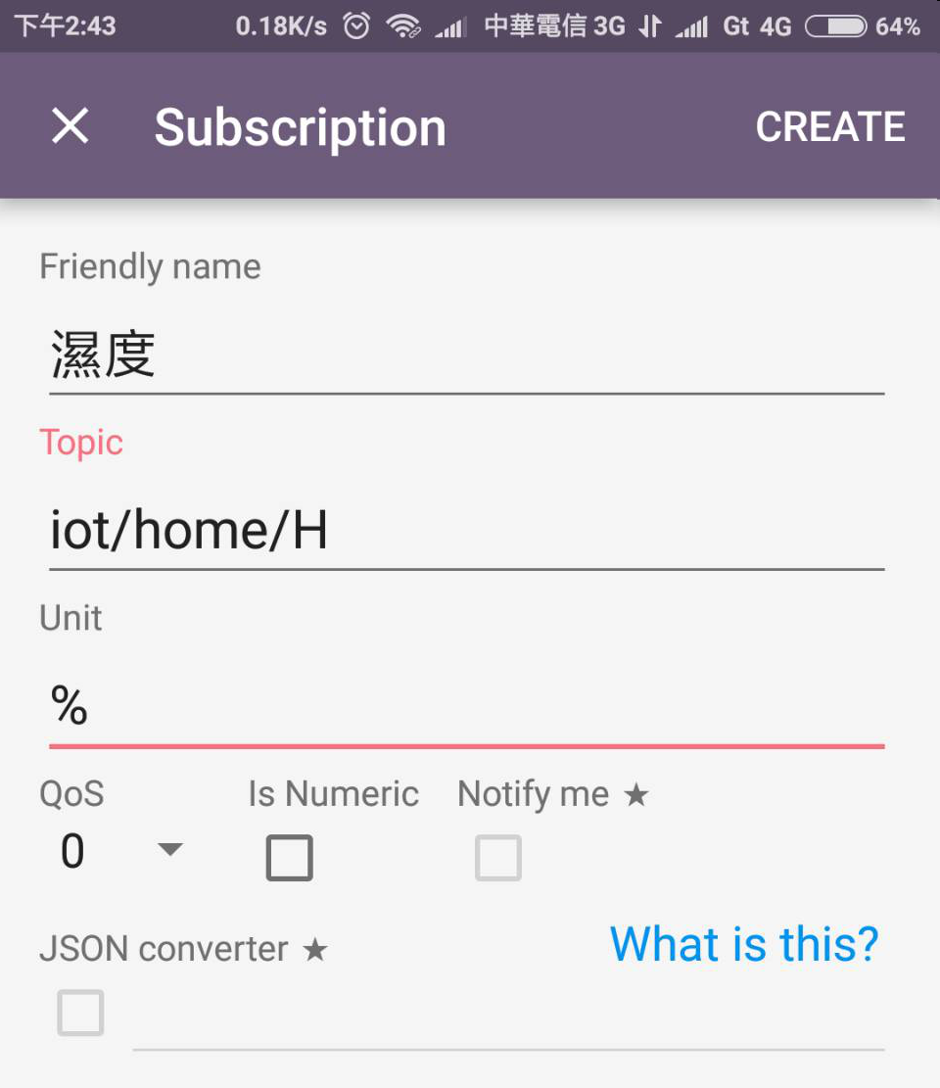
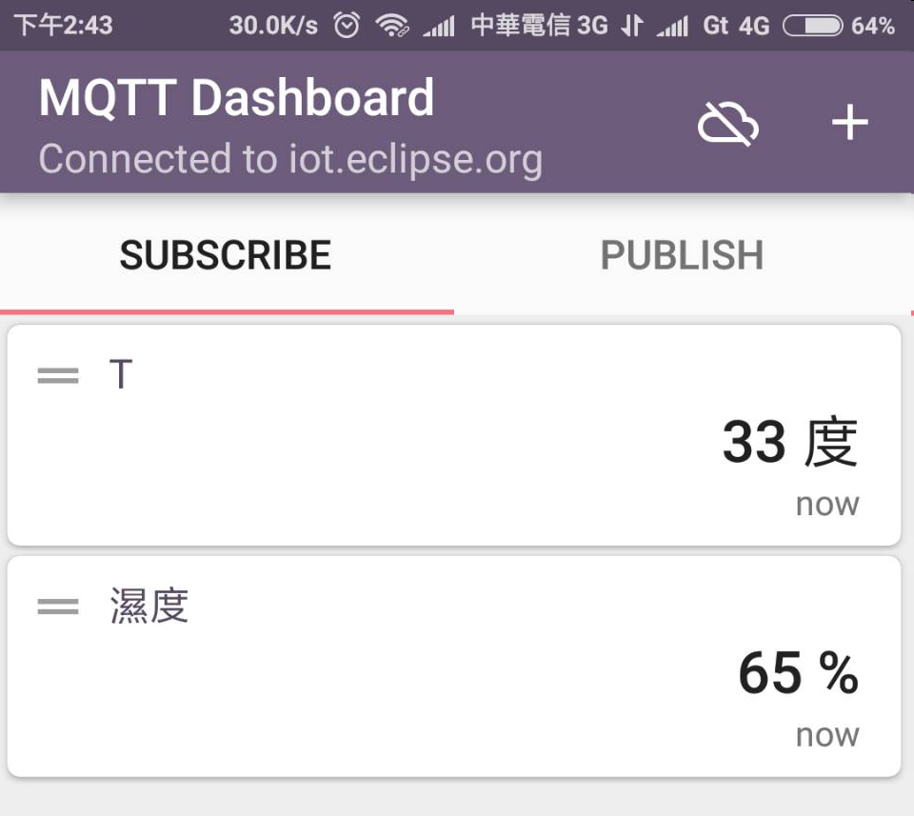
MQTT
(5)
按+新增一個訂閱(Subscript)的 主題(Topic)
(5)填入如圖的內容
將得到如圖的畫面

Slide 22
5.
Control a light or switch
Let’s start with the first set of slides

Slide 23
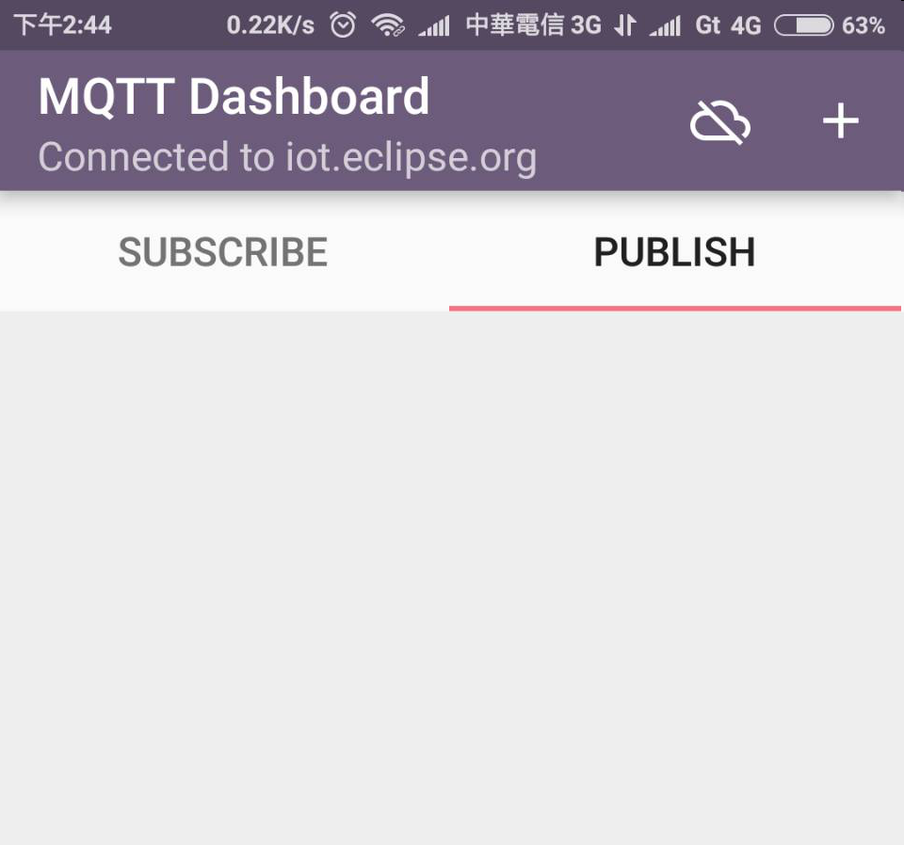
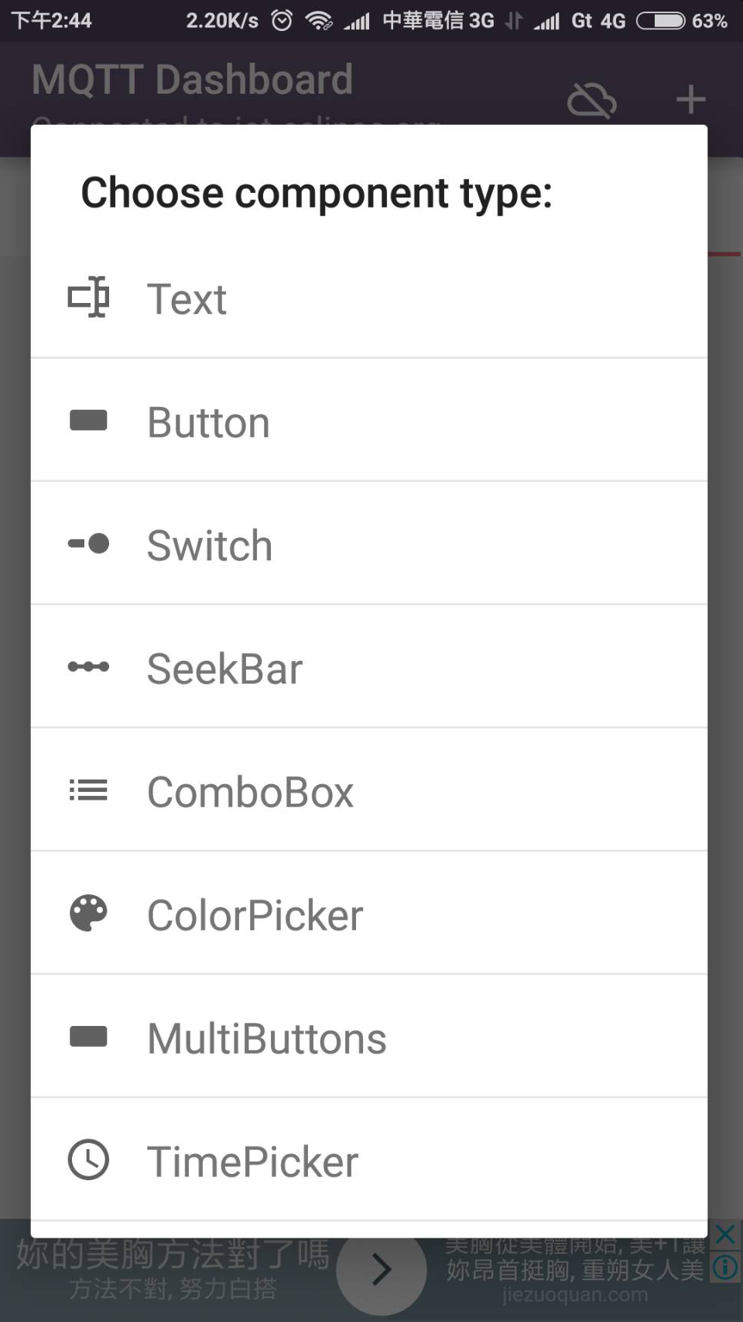
MQTT
(6)
(6)按+新增一個public的 主題(Topic)
(7)選擇Switch
(7)

Slide 24
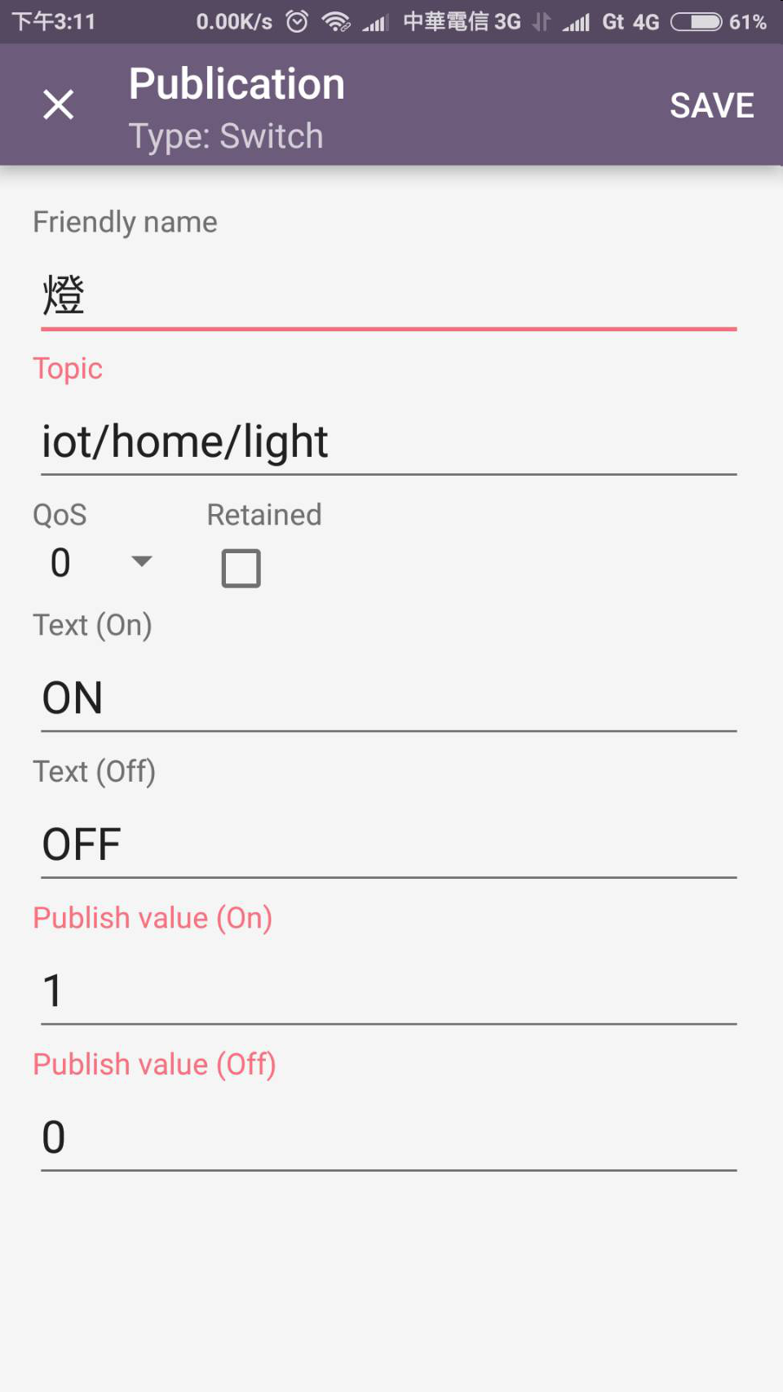
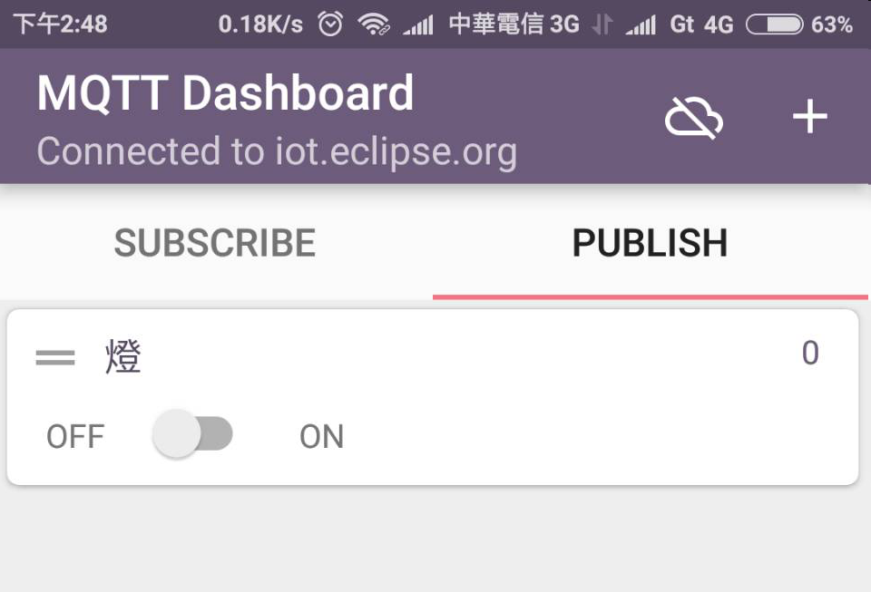
MQTT
(8)填入內容如圖
可以得到畫面如下
點switch可以控制ESP上的燈號
(7)

Slide 25
6.
Make a chart
Let’s start with the first set of slides

Slide 26
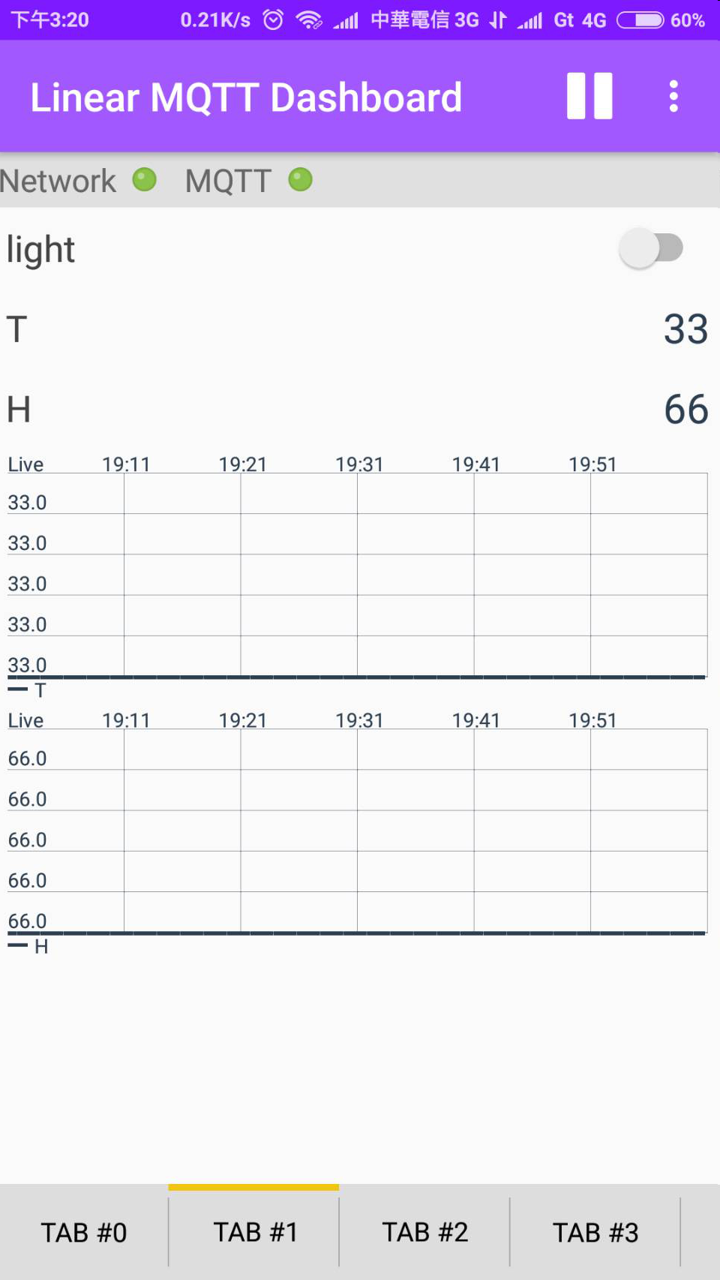
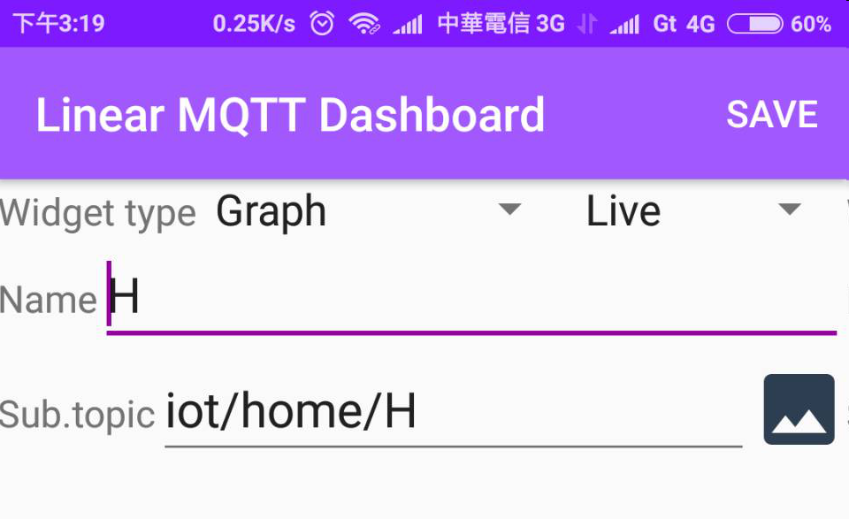
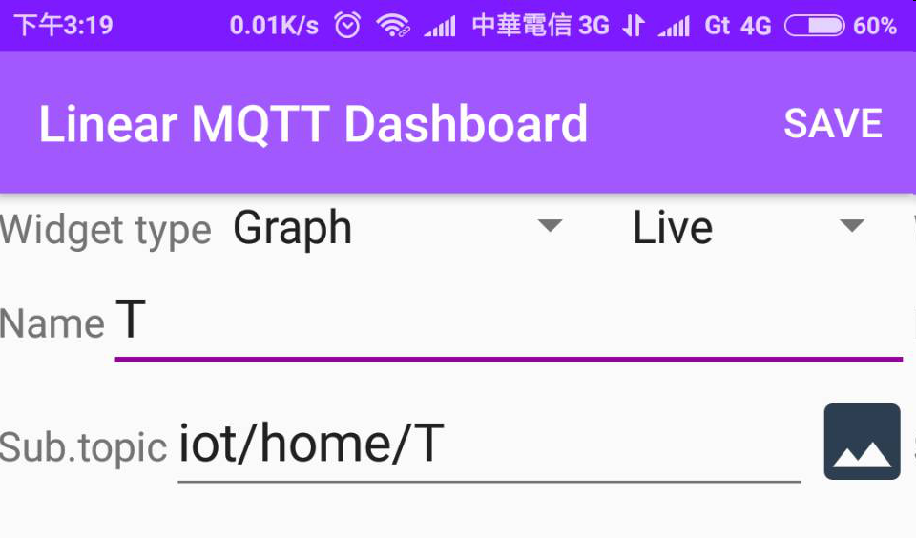
Make a chart
(4)
安裝Linear MQTT Dashboard。
操作如圖所示
(5)
(1)
(3)
(2)

Slide 27
7.
More about MQTT
Let’s start with the first set of slides

Slide 28
漏掉資料?
在Broker的Server上同時有MQTT Client訂閱topic，直接放到DB中
把qos level提升

Slide 29
THANKS!
Any questions?
You can find me at jumbokh@gmail.com

